Slide 1
How to Teach Computers to Recognize Things S2: Dataset Preparation: Building our Perfect “Textbooks”
Dr. Du Pengfei
CPPS/DMD
30 Mar 2023

Slide 2

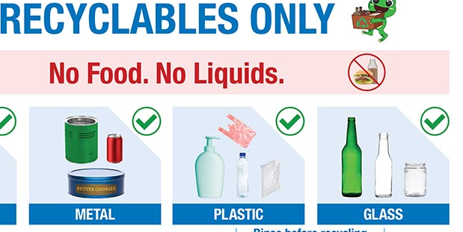
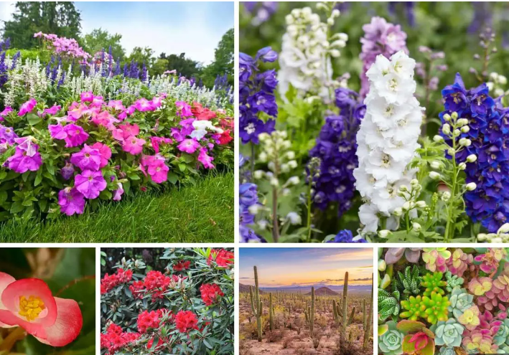
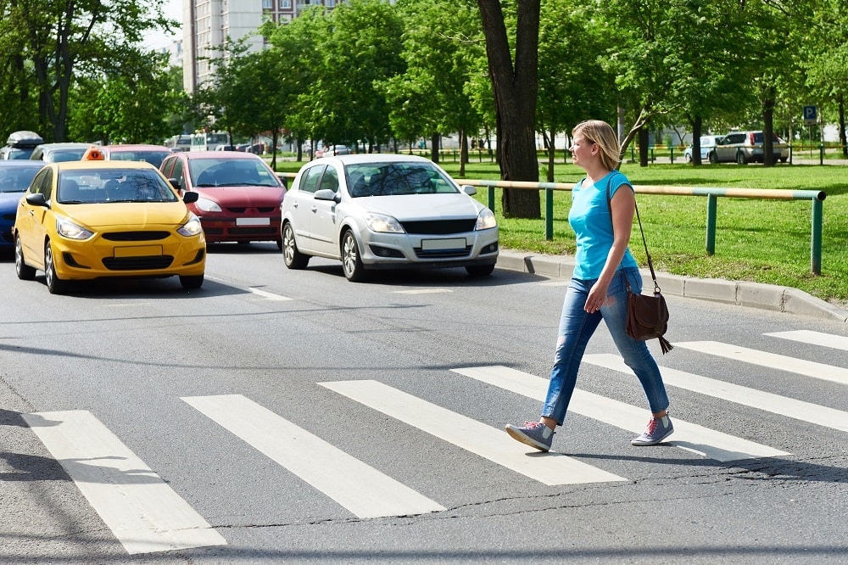
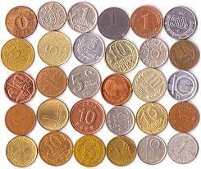
Recap: Group Task Selection
A. Person Protection Equipment (hats, goggles and vests)
B. Recyclables (Cans, Bottles, etc.)
C. Coins (5 cents, 1 dollar and 50 cents, etc.)
D. Pedestrians and Cars
E. Flowers and Plants

Slide 3

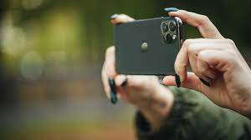
Agenda
First half: Image preparation and Filtering
Second half: Group Presentation of the image set preparation

Slide 4
Rules of Thumb: Pictures Filtering
Assure one single object per image [Try image crop tool]
No blurry images
Complete Object (No occlusion or obstruction or partial body)
Relatively clear background (Sufficient Contrast)
Balanced Label

Slide 5


Examples: Cars
Notes:
https://www.youtube.com/watch?v=2hXG8v8p0KM

Slide 6
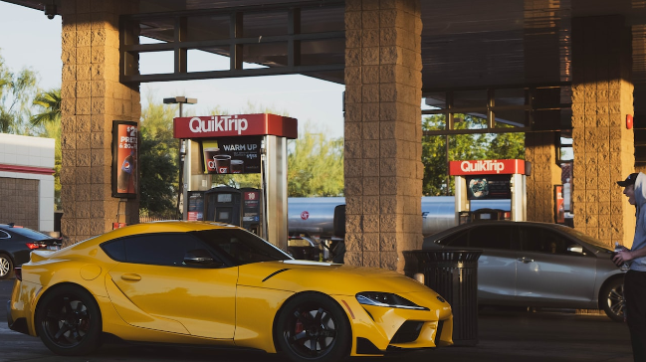

Examples: Cars
Notes:
https://www.youtube.com/watch?v=2hXG8v8p0KM

Slide 7
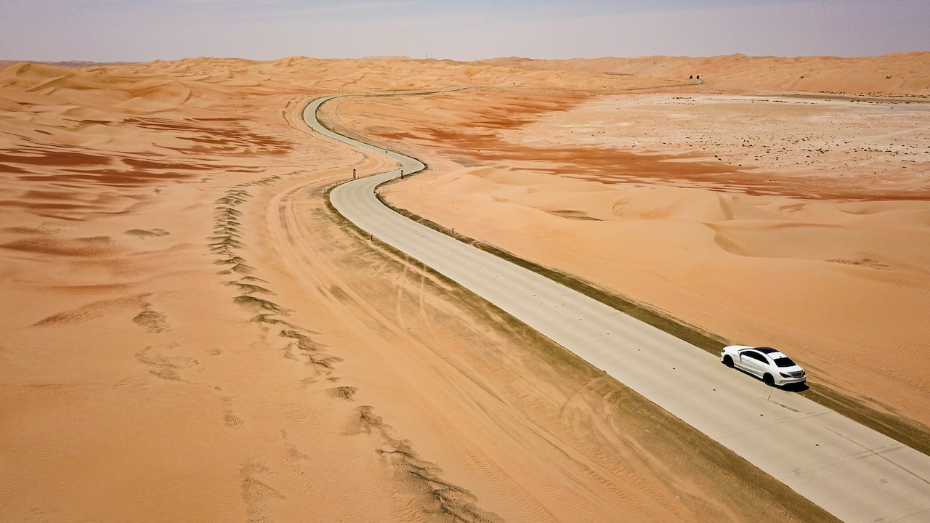
Examples: Cars
Notes:
https://www.youtube.com/watch?v=2hXG8v8p0KM

Slide 8

Examples: Cars
Notes:
https://www.youtube.com/watch?v=2hXG8v8p0KM

Slide 9
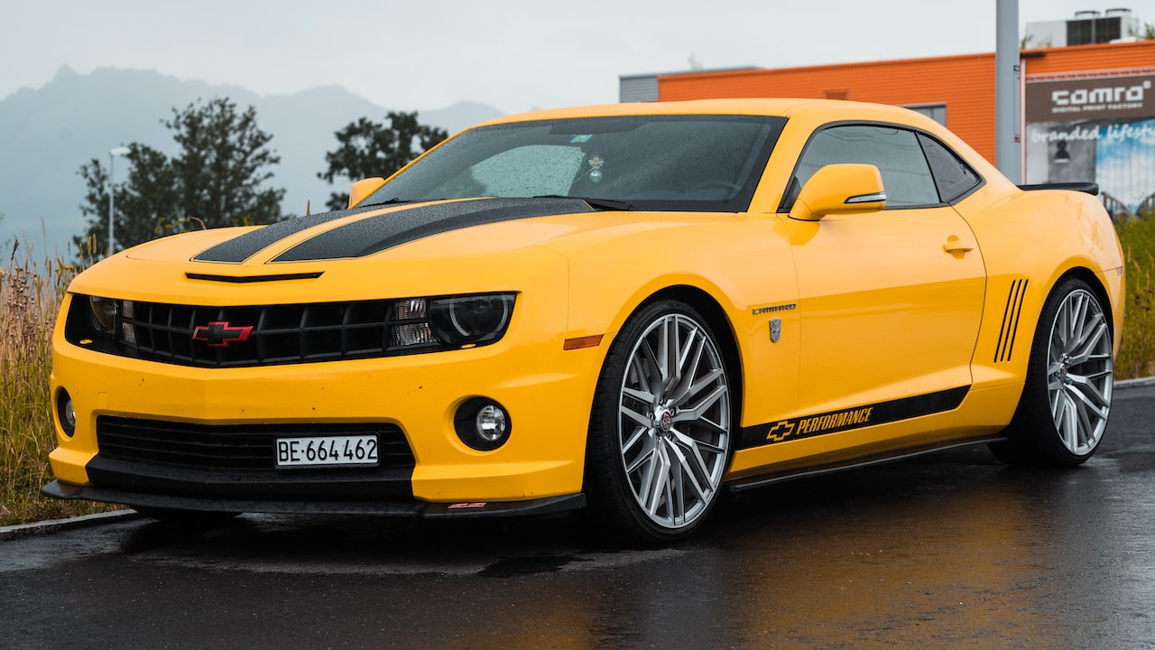
Examples: Cars
Notes:
https://www.youtube.com/watch?v=2hXG8v8p0KM

Slide 10

Examples: Cars and People
Notes:
https://www.youtube.com/watch?v=2hXG8v8p0KM

Slide 11
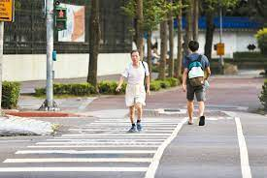
Examples: Cars and People
Notes:
https://www.youtube.com/watch?v=2hXG8v8p0KM

Slide 12
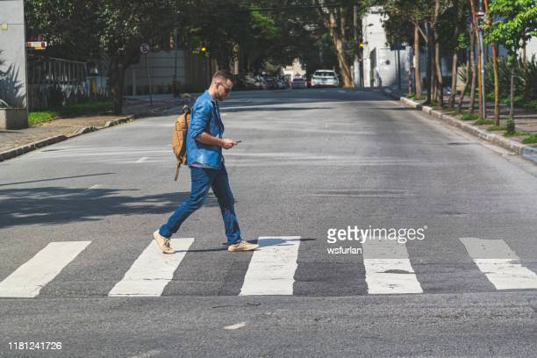
Examples: Cars and People
Notes:
https://www.youtube.com/watch?v=2hXG8v8p0KM

Slide 13
Examples: Cars and People
Notes:
https://www.youtube.com/watch?v=2hXG8v8p0KM

Slide 14
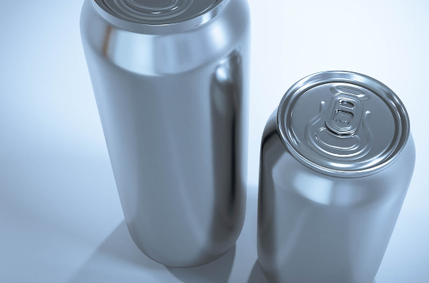
Examples: Recyclables
Notes:
https://www.youtube.com/watch?v=2hXG8v8p0KM

Slide 15

Examples: Recyclables
Notes:
https://www.youtube.com/watch?v=2hXG8v8p0KM

Slide 16
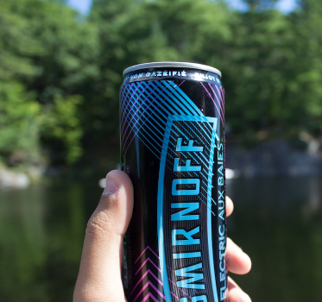
Examples: Recyclables
Notes:
https://www.youtube.com/watch?v=2hXG8v8p0KM

Slide 17
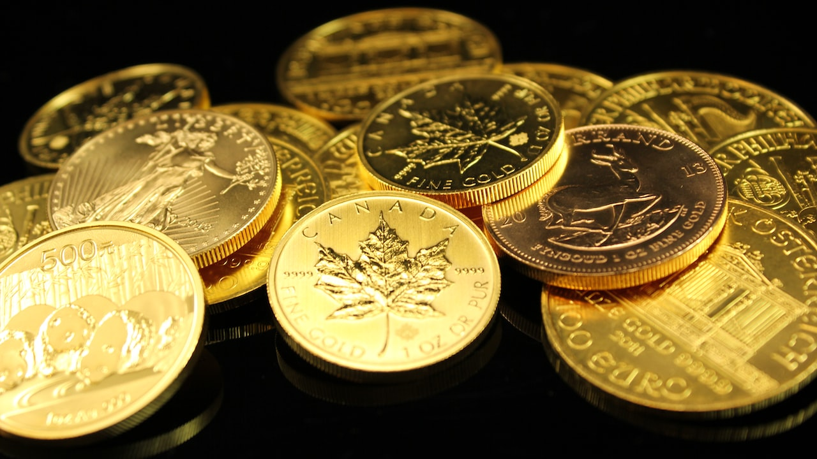
Examples: Coins
Notes:
https://www.youtube.com/watch?v=2hXG8v8p0KM

Slide 18

Examples: Coins
Notes:
https://www.youtube.com/watch?v=2hXG8v8p0KM

Slide 19
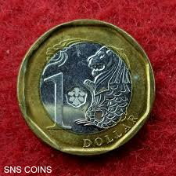
Examples: Coins
Notes:
https://www.youtube.com/watch?v=2hXG8v8p0KM

Slide 20
Let’s Start!! Online First, Then Taking Pictures, Then Filtering
Stop when your group reach 250 qualified images!
Upload to your google drive and share to my account as well: potatodu1216@gmail.com
Notes:
https://www.youtube.com/watch?v=2hXG8v8p0KM

Slide 21
Group Sharing:
What images you have kept, what images you have phased out?
Notes:
https://www.youtube.com/watch?v=2hXG8v8p0KM

Slide 22
Contact: Du Pengfei
du_pengfei@SIMTech.a-star.edu.sg

Slide 23
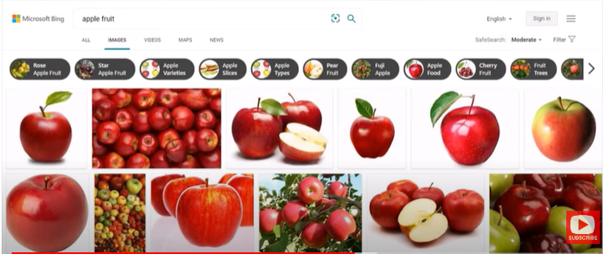
Extension: Bing Image Downloader
https://youtu.be/solASfMs89Q
Notes:
https://www.youtube.com/watch?v=2hXG8v8p0KM

Slide 24
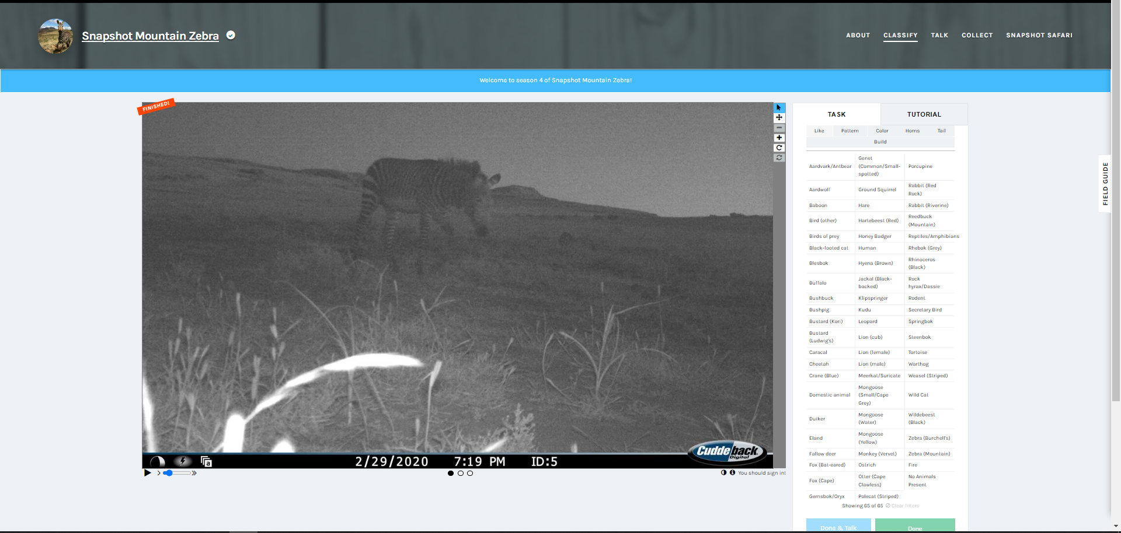
Extension: Help Classify Animals at Mountain Zebra National Park
https://www.zooniverse.org/projects/meredithspalmer/snapshot-mountain-zebra/classify?reload=0&workflow=11445
Help Classify Animals at Mountain Zebra National Park
Snapshot Safari has placed hundreds of hidden cameras across southern Africa, capturing millions of images of beautiful and rare animals.
Students can help protect the endangered Cape Mountain Zebra by classifying the different animals in these images. You can read about the project here or click below to give it a try!
Notes:
https://www.youtube.com/watch?v=2hXG8v8p0KM

